Slide 1
Digital Electronics(18EC34)
By
Mrs Kokila K S
Asst Prof
Dept of ECE ,BGSIT

Slide 2
Introduction
to
Logic Gates

Slide 3
What are Logic Gates?
Description …
Basic building blocks of a digital circuit
Data processing on the circuit is controlled using transistors
Output depends on the logic gate and the input
Input is one of two states – high or low
Output is one of two states – high or low
There are seven types of logic gates

Slide 4
What are Logic Gates?
There are three basic types of logic gate.
AND gate
OR gate
NOT gate

Slide 5
The AND Gate
Symbol

Slide 6
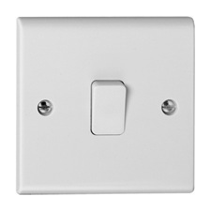
The AND Gate

Slide 7
The OR Gate
OR Gate

Slide 8
The OR Gate

Slide 9
The NOT Gate
The logical inverter

Slide 10
The NOT Gate

Slide 11
Thinking in Binary
+
-
HIGH
LOW
YES
NO
TRUE
FALSE
1
0

Slide 12
True or False?
The AND Gate
TRUTH TABLE
A
B
Q
0
0
0
A
Q
0
1
0
B
1
0
0
1
1
1

Slide 13
True or False?
The OR Gate
TRUTH TABLE
A
B
Q
0
0
0
A
Q
0
1
1
B
1
0
1
1
1
1

Slide 14
True or False?
The NOT Gate
TRUTH TABLE
A
Q
0
1
A
Q
1
0

Slide 15
Combining Logic Gates
An AND gate and a NOT gate
A
C
Q
B

Slide 16
Combining Logic Gates
NAND gate
A
C
Q
B

Slide 17
Combining Logic Gates
An AND and
NOT Gate (NAND)
TRUTH TABLE
A
B
C
Q
0
0
0
1
A
C
0
1
0
1
Q
B
1
0
0
1
1
1
1
0
Q = NOT (A AND B)

